Slide 1

Business Performance & Strategic Insights
Data analyst - Aironas Vinickas
2025 02 20

Slide 2
Today’s Agenda
Main KPIs overview
Online vs. Offline comparison
Profit Margin vs. Revenue overview

Slide 3
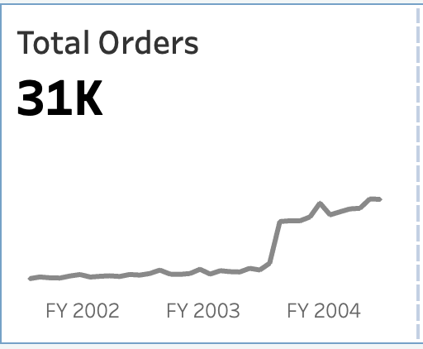
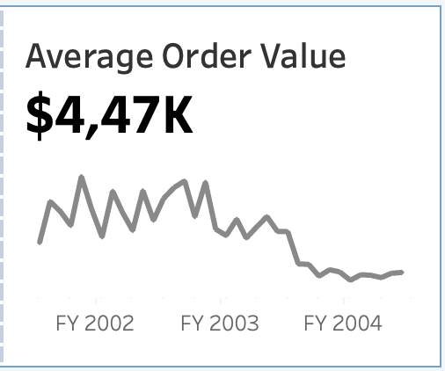
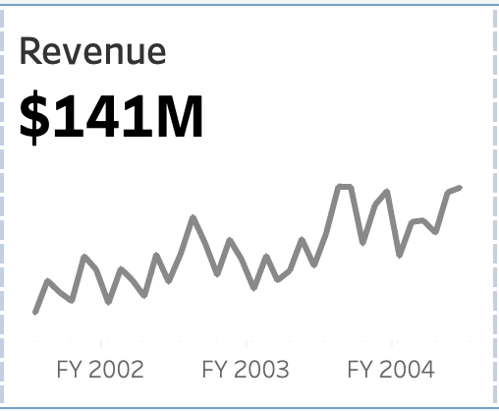
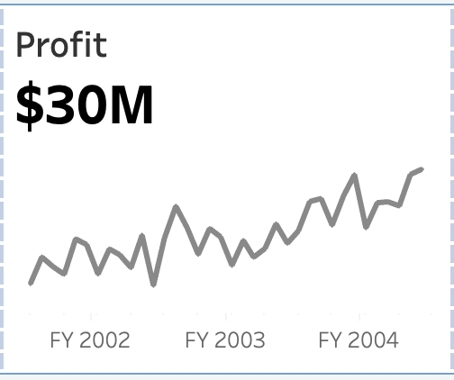
Strong Growth in Orders, Revenue & Profit – AOV Decline Signals Shift in Buying Behavior
Significant increase in orders amount by 189% in 2003 August vs. July – sustaining a strong upward trend
AOV drops 50% in 2003 August vs. July – potentially related to a shift in buying behaviour
Revenue surges 40% in 2003 August vs. July – reinforcing a solid growth momentum
Profit climbs by 36% in 2003 August vs. July – maintaining strong growth

Slide 4
How does online vs. offline tendencies contribute to this?

Slide 5
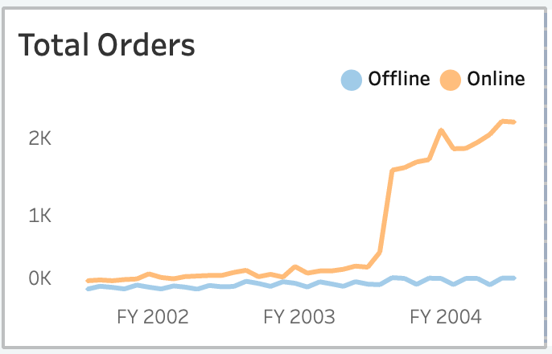
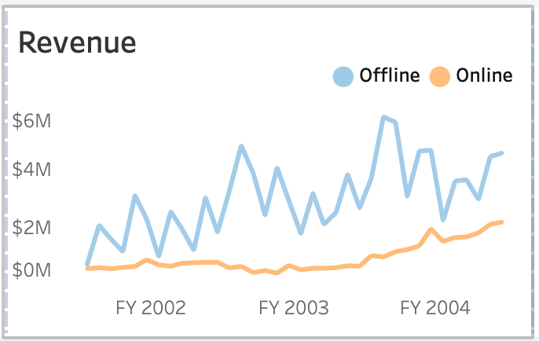
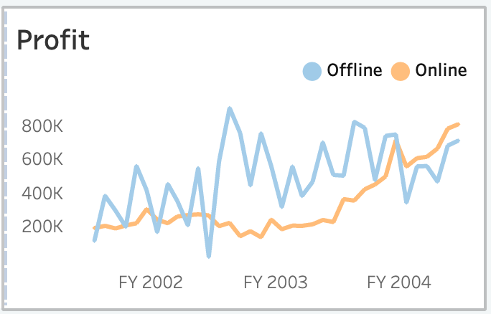
Online Sales Drive Growth - A Structural Shift in Sales Tendencies?
Significant increase in orders is driven by strong online sales growth – highlighting a possible shift in customer purchasing behaviour
Offline sales revenue remains higher but volatile while online sales revenue shows steady and sustainable growth.
Offline profit is generally higher but volatile, while FY 2004 marks a shift – online profit surpasses offline despite lower revenue.

Slide 6
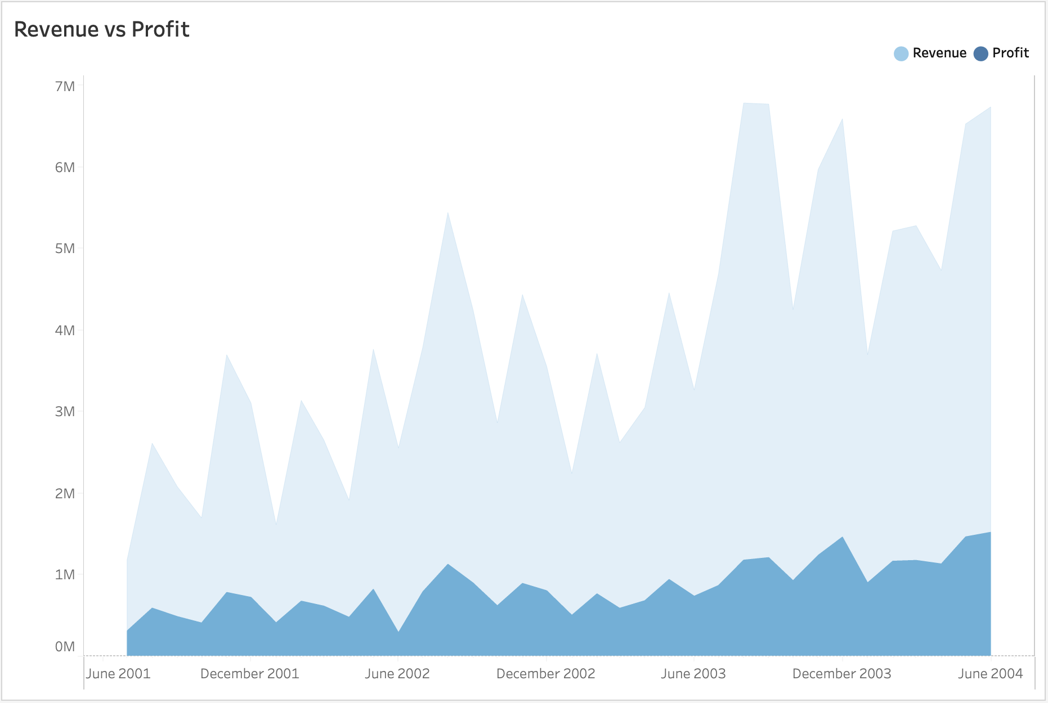
Are we sacrificing profit margins to drive revenue growth?
Revenue is growing rapidly, but profit is increasing at a slower pace. Lower-price strategy appears to be driving online sales and scaling revenue, yet profit growth remains modest.
How can we optimize profitability more while sustaining growth?

Slide 7
Conclusions
- Evaluate the impact of the current lower-price strategy to balance between driving sales volume and maintaining healthy margins. Consider testing premium offers or bundling strategies to increase AOV without reducing sales.
- To ensure sustainable growth, consider how the brand is positioned in the market - quality vs. price - and refine the messaging to support a balance between pricing, quality, and customer experience.
How can we balance aggressive growth with sustainable profitability in both online and offline sales?

Slide 8
Questions | Discussion

Slide 9
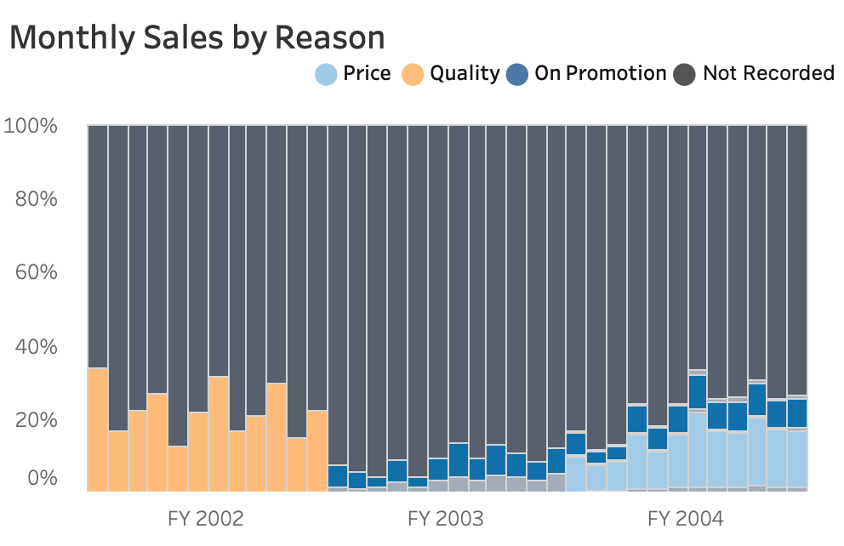
Price and Promotion: a potentially solid combination for Driving Online Sales
Quality declined as a factor and price spiked in 2004. Price and Promotion have the potential to be a strong combination for driving online sales. Looking ahead, how will we strategically position our products for sustainable growth?
What lies behind Not Recorded?

